Slide 1
Hello
<Foocamp />.
CSS basics

Slide 2
Agenda.
What is CSS
How to add style to our HTML
Anatomy of a CSS rule set
CSS Selectors
Animations intro <3

Slide 3
1
What is CSS

Slide 4

What is CSS?
Is what adds style to our websites.
It solves questions like:
How I do my text red
How do I display an element in certain position
How do I decorate my webpage background and colors?
Cascading Style Sheets
Notes:
4 más grande fabricante de automóviles del mundo

Slide 5
2
How to add CSS to HTML

Slide 6
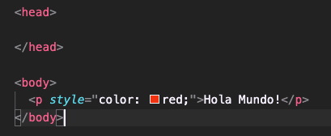
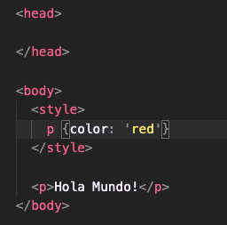
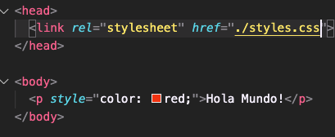
Adding CSS to your HTML
2. Inline Styling
1. Style Tag
3. Link tag
Notes:
4 más grande fabricante de automóviles del mundo

Slide 7
Demo Time!

Slide 8
3
Anatomy of a CSS rule set

Slide 9
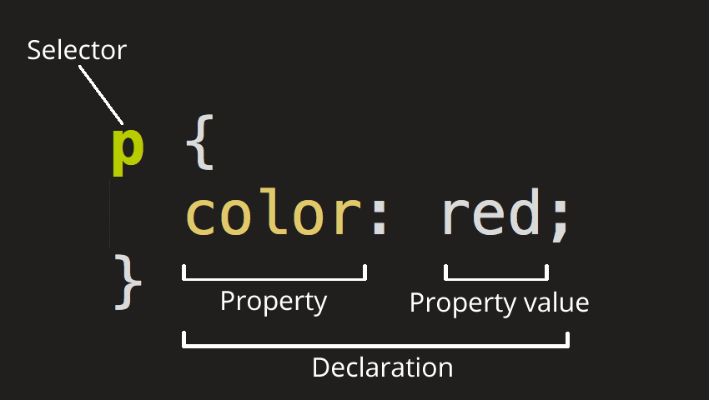
CSS Basics - Rules and Selectors
Notes:
4 más grande fabricante de automóviles del mundo

Slide 10
But wait!

Slide 11
What does Cascading mean?
CSS is not a programming language. It’s not a markup language either. It is a style sheet language
… This means, we are going to create sheets to define our styles by creating rules to declare those styles.
But.. what happens if we have multiple styles affecting one single element? Which rule will be prioritized (...chan, chan, chan)
Let’s see...
Notes:
4 más grande fabricante de automóviles del mundo

Slide 12
4
CSS Selectors

Slide 13
CSS Selectors
Element
h1
PseudoClass
a:hover
ID
#my-id
Class
.my-class
Notes:
4 más grande fabricante de automóviles del mundo

Slide 14
Demo Time!

Slide 15

Demo - Homework
Colors:
Black: #33333
Orange: #F49731
Green: #08585C
Yellow: #00000
Notes:
4 más grande fabricante de automóviles del mundo

Slide 16
Links
Emmet
CodePen
VSCode - Live Server (Usado para levantar un servidor y aplicar los cambios a la página en vivo, sin necesidad de recargar el navegador)
MDN (learning)
Animations CSS Tricks (learning)
Notes:
4 más grande fabricante de automóviles del mundo

Slide 17
Bonus
Animations!

